Slide 1
Lecture 12
Neighborhoods and Human Development: The international situation
12.3 Heterogeneity and Change in Developing Cities, Human Development
IUS 6.2.2
© Luís M. A. Bettencourt 2024

Slide 2
Neighborhoods are the important scale for:
Well-being and human development (especially children)
Inequality and segregation
Community organization and “P”olitics

Slide 3
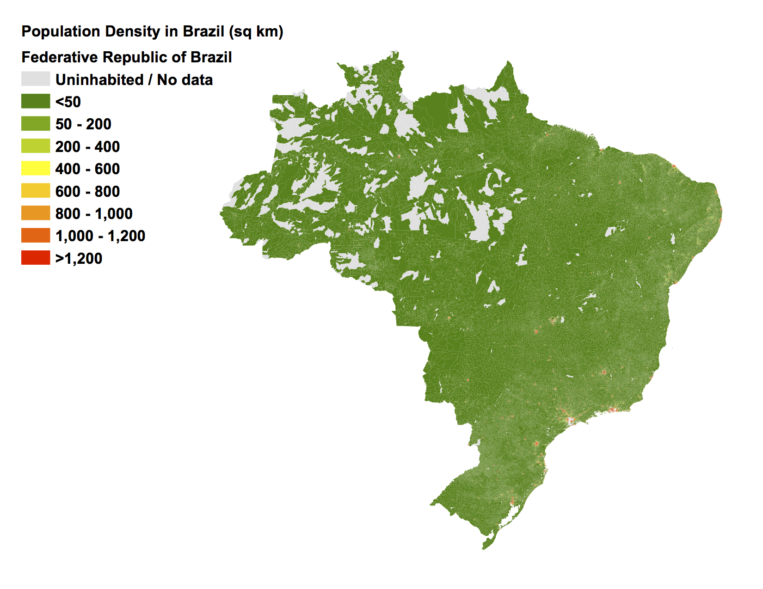
Population Density
(people/km²)
0 300 600 900 1200 km

Slide 4
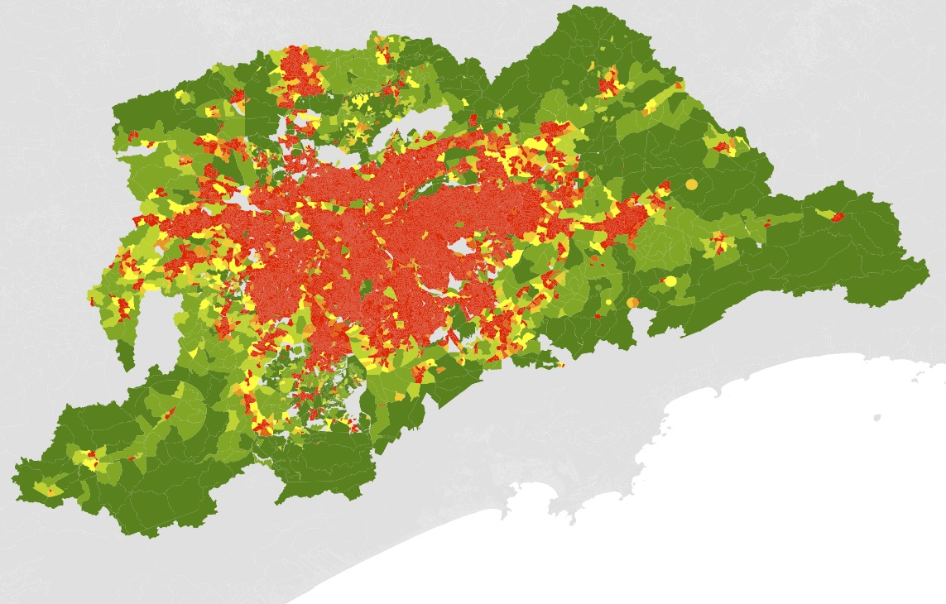
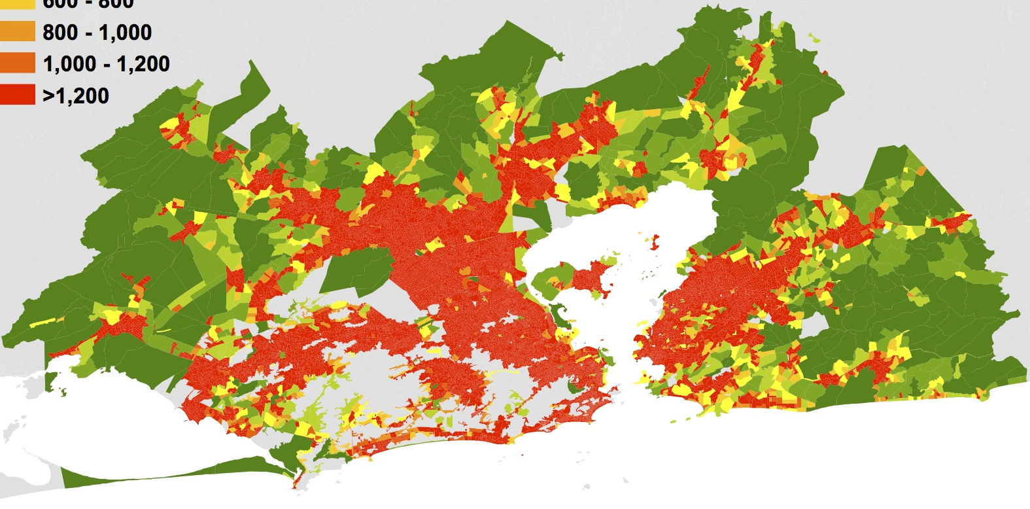
Sao Paulo
Population Density
(people/km²)
Rio de Janeiro

Slide 5
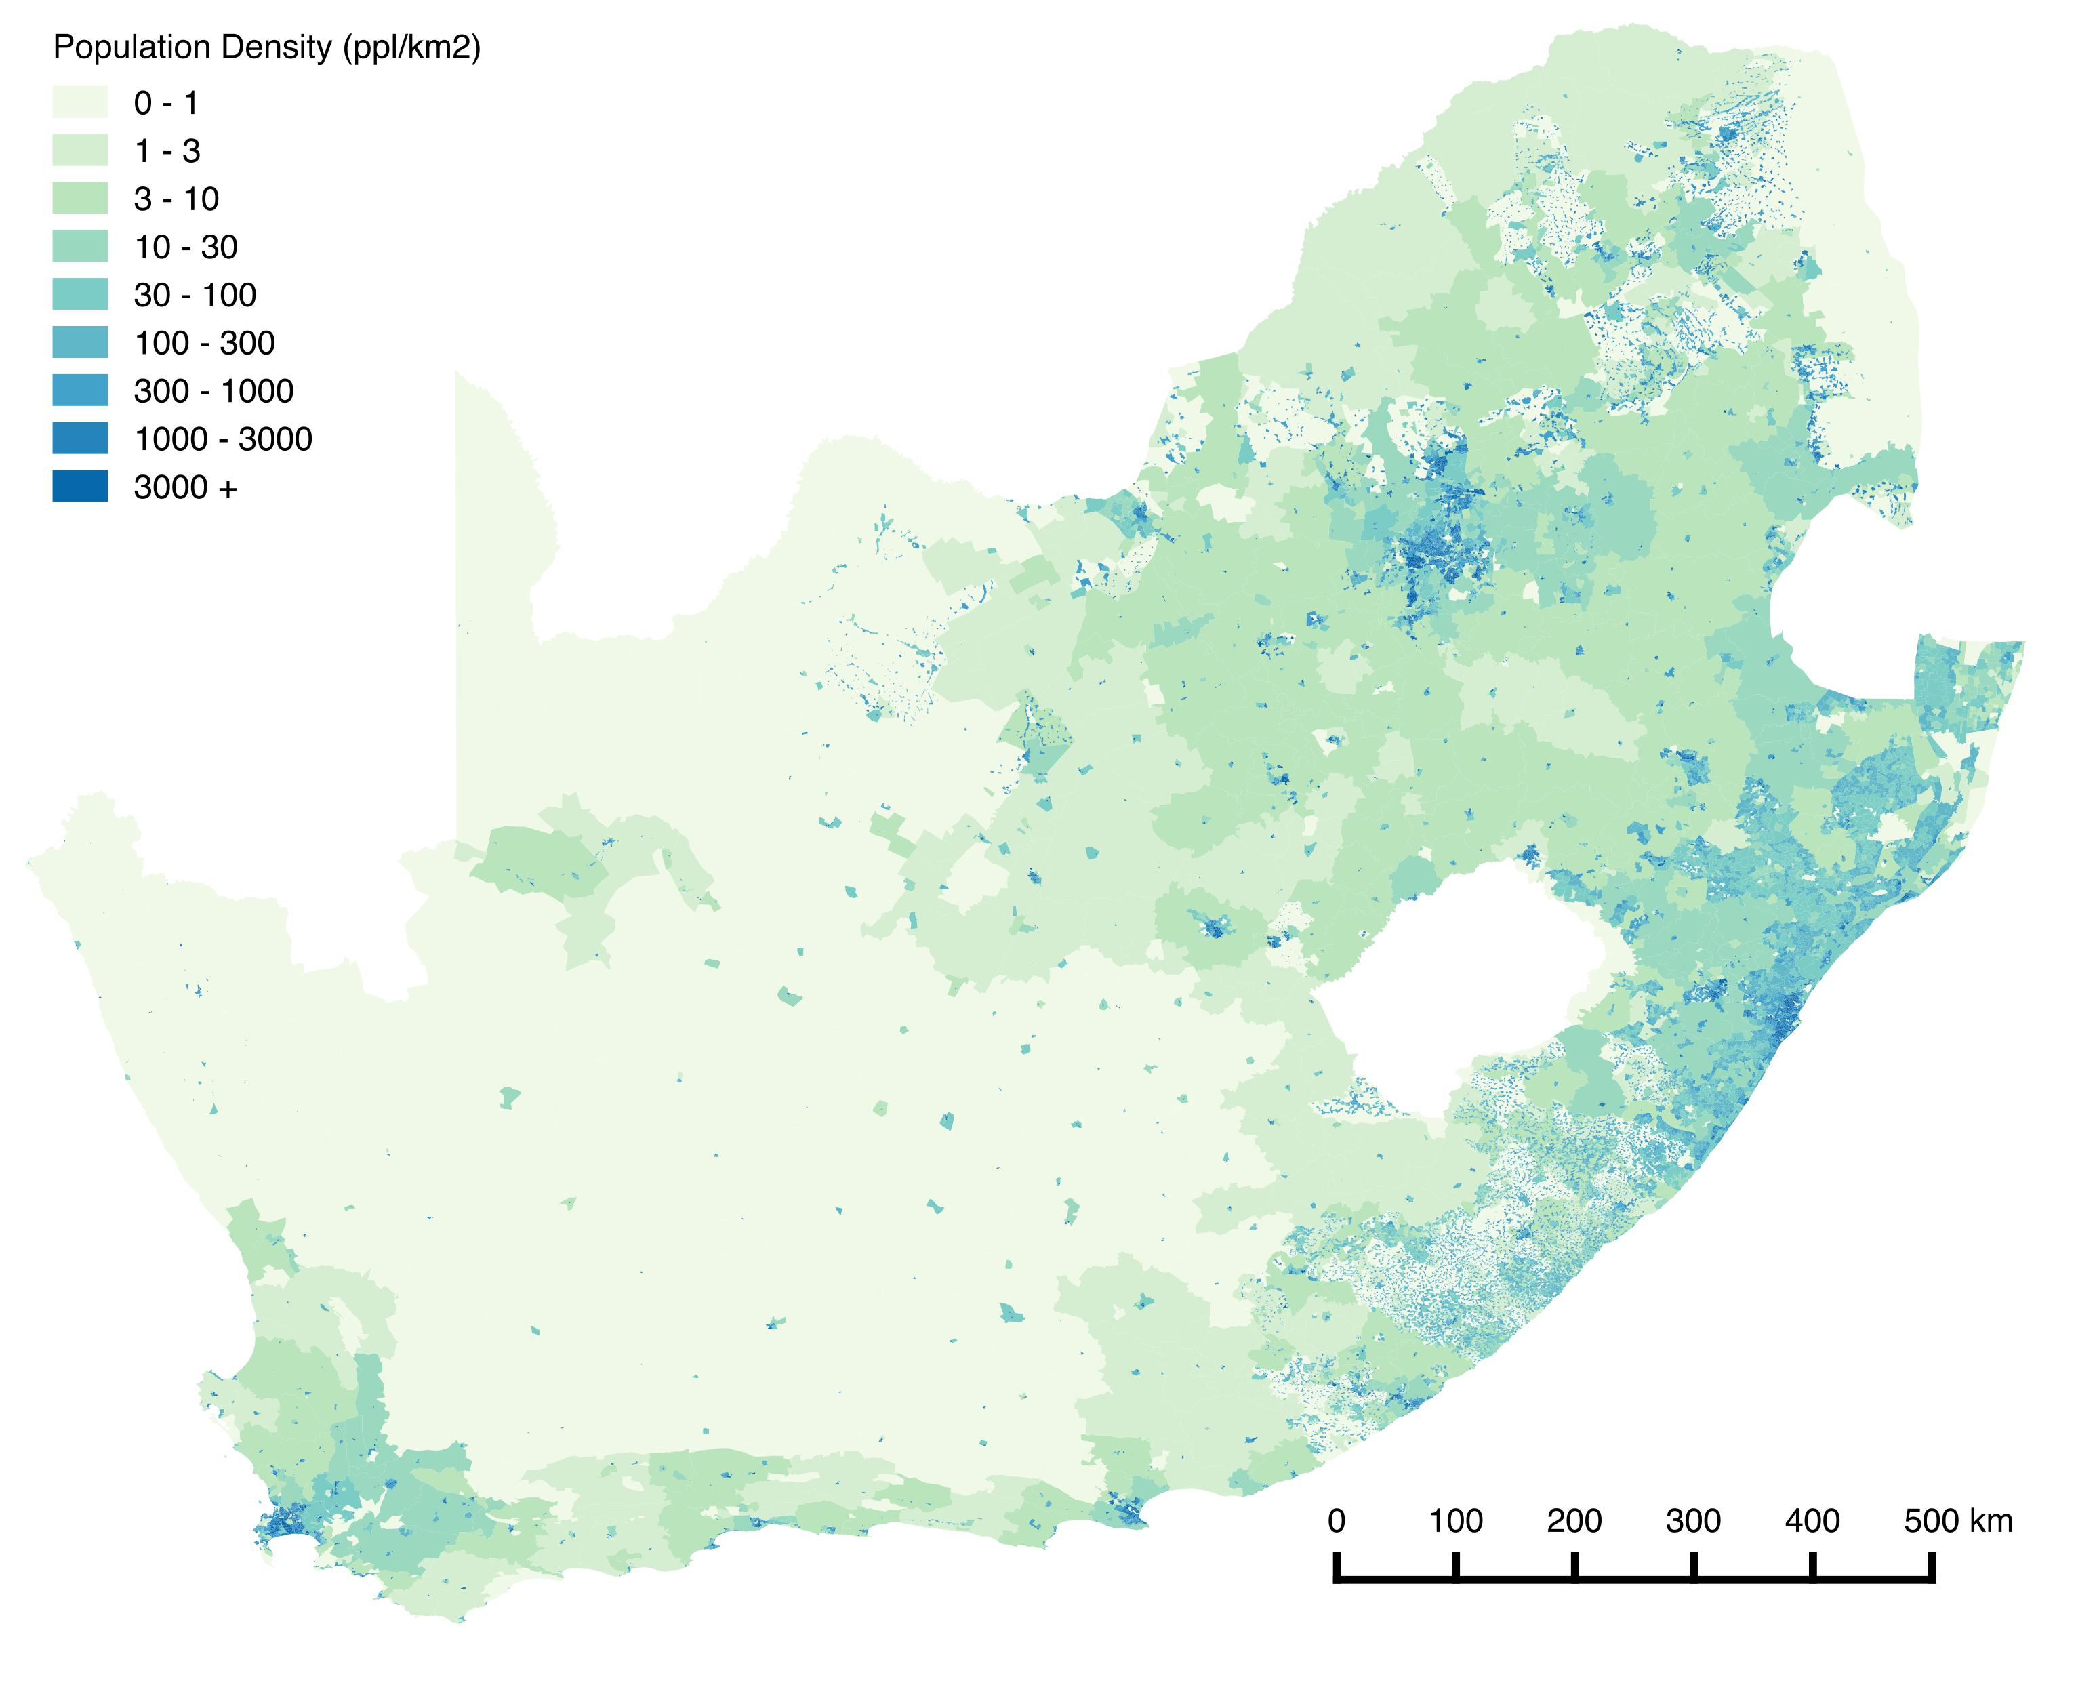

Slide 6
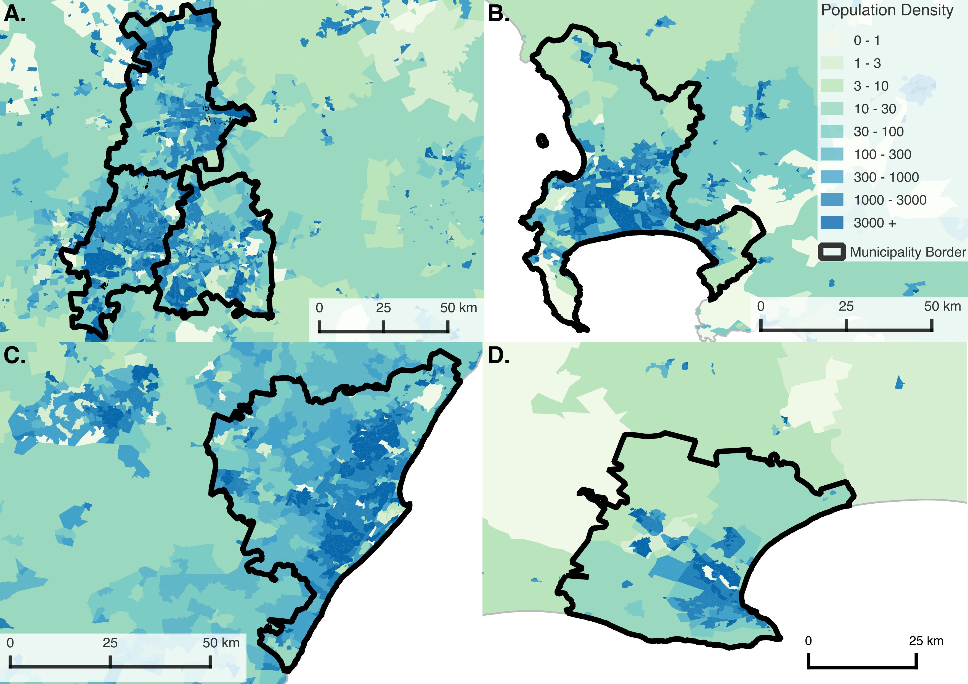
Notes:
A: Johannesburg, Ekurhuleni Metro (East Rand), City of Tshwane Metro (Pretoria):
B: Cape Town
C: Ethekwini Metro (Durban)
D: Nelson Mandela (Port Elizabeth)

Slide 7
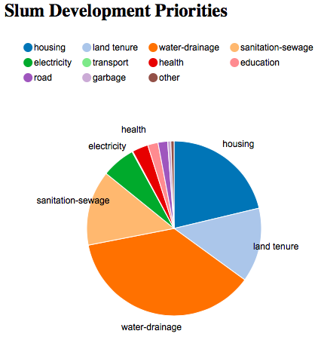
Self Identified Development Priorities

Slide 8

Self Identified Development Priorities

Slide 9
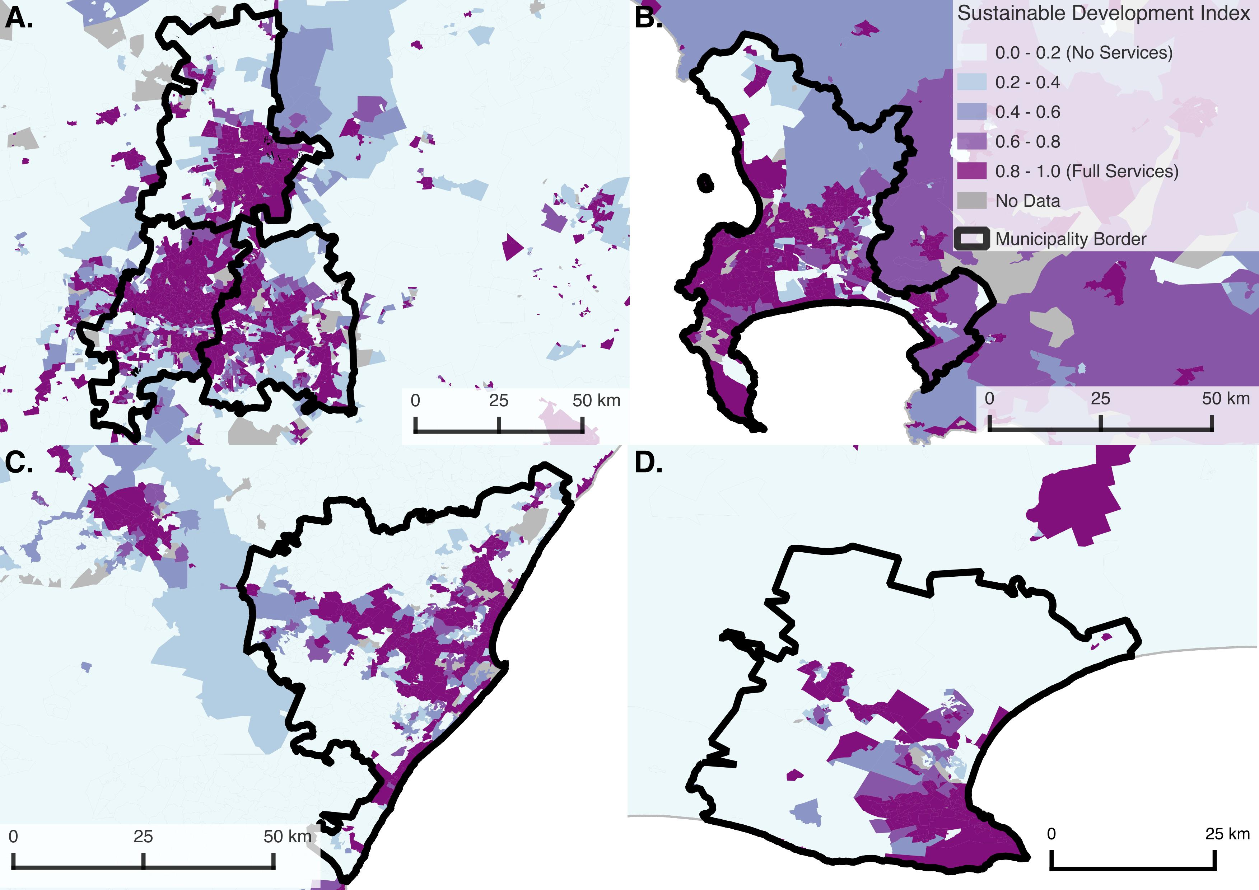

Slide 10
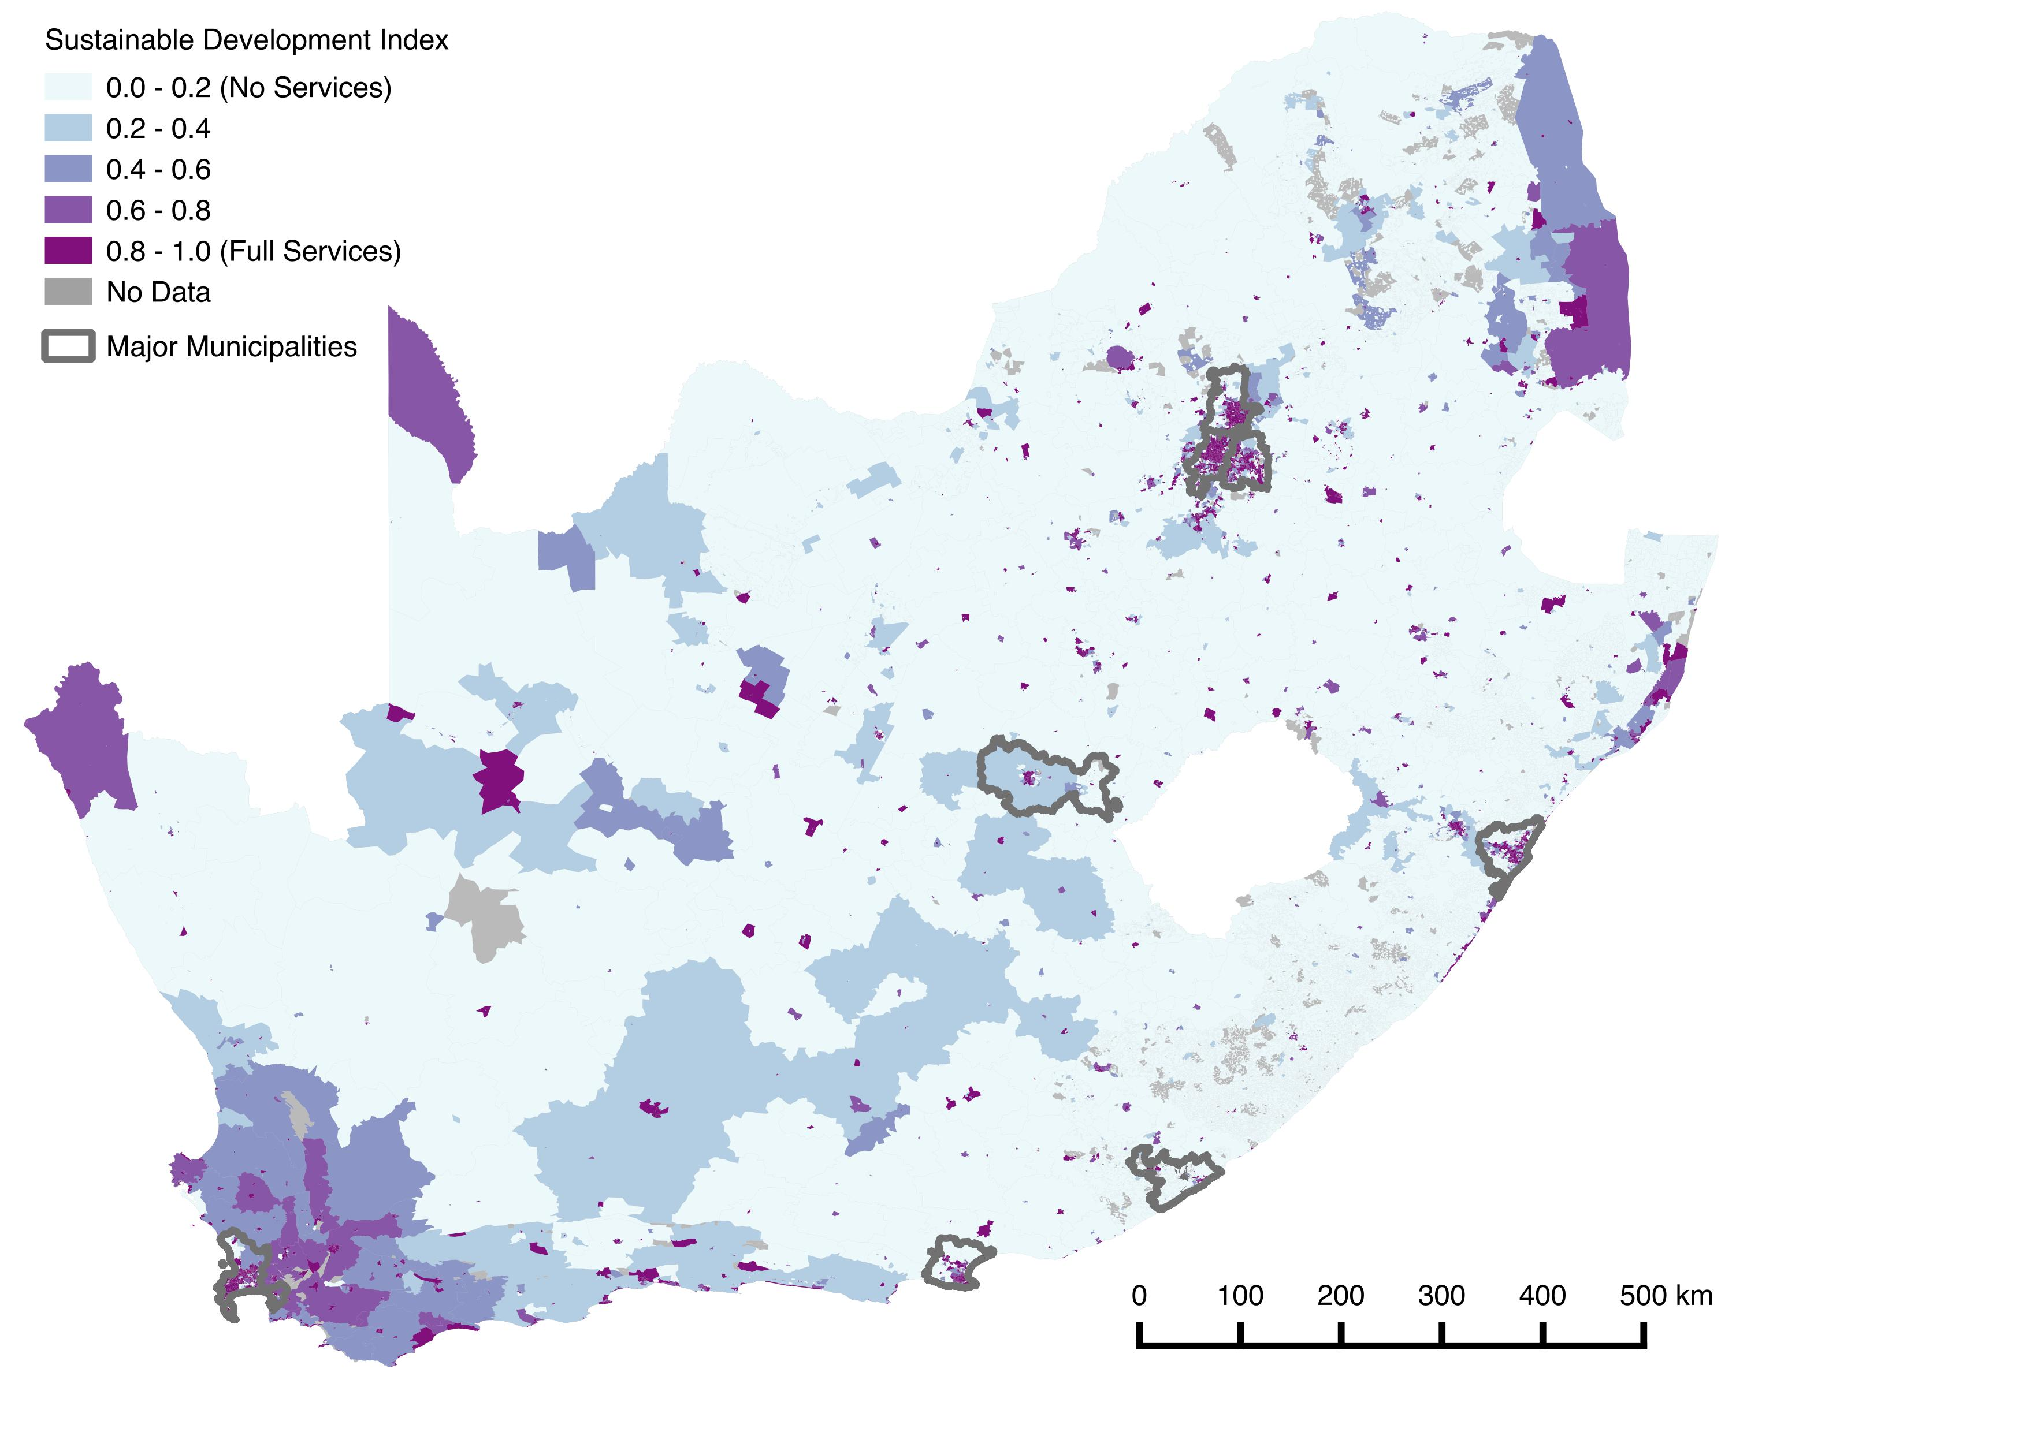

Slide 11
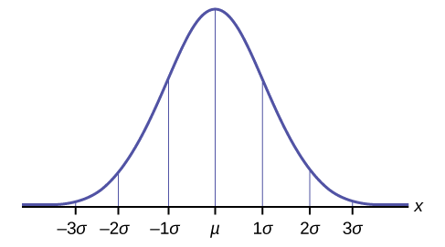
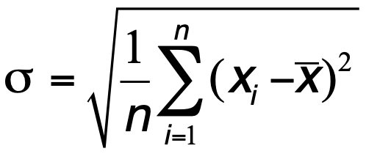
Measures of Heterogeneity
Standard deviation

Slide 12
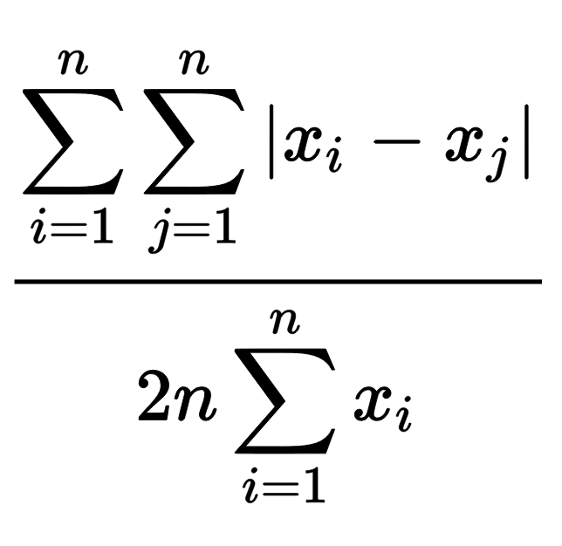
Measures of Heterogeneity
Standard deviation
Gini Coefficient
G =
Notes:
Measures of heterogeneity may be spatially explicit, or they may consider only the variation within a population, independently of any spatial structure.
The simplest measure of variation within a population is the standard deviation, and its relation to the mean of any socioeconomic variable.
The Gini coefficient is a well-known non-spatial measure of heterogeneity, often discussed in the context of income or wealth inequality.
Moran's I, by contrast, is one of the more widely used measures of spatial heterogeneity. It accounts for the level of similarity between the values of a given characteristic at two locations within a given distance from each other.
The Gini coefficient (or the standard deviation) and Moran's I are not necessarily correlated as this depends on the spatial structure of mixing between different populations. Any distribution of a resource within a population that shows some level of variation between individuals can be spatially distributed in a manner that is maximally clustered, meaning that Moran's I approaches I = 1, or perfectly anti-correlated (as in a checkerboard pattern) so that Moran's I approaches I = -1, or a random pattern, when Moran's I approaches I = 0.

Slide 13
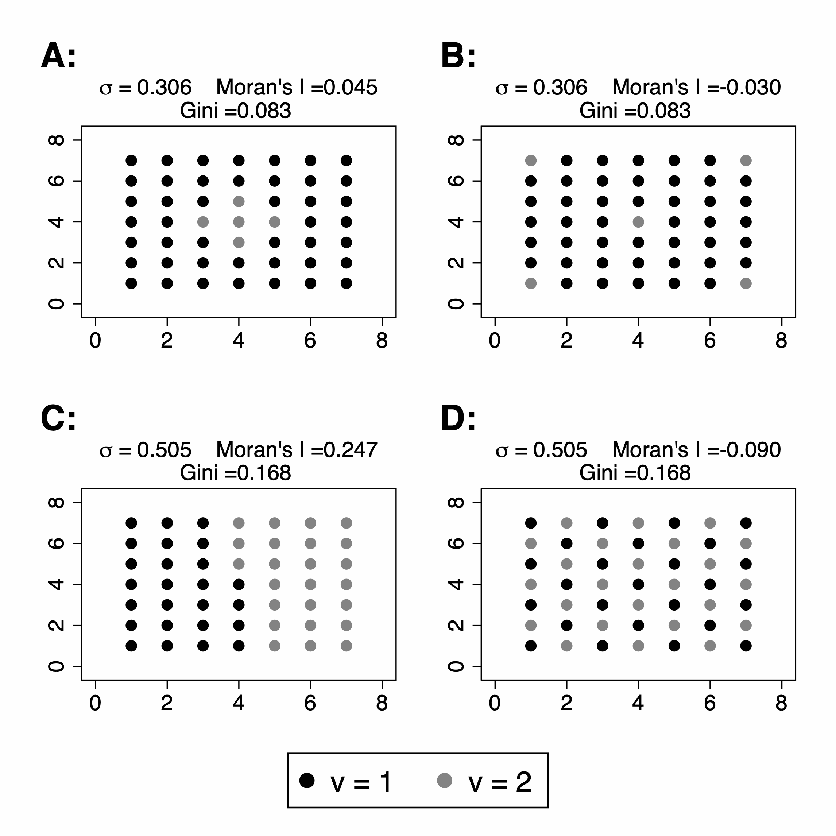
Spatial sorting and inequality
Same inequality
Same inequality

Slide 14
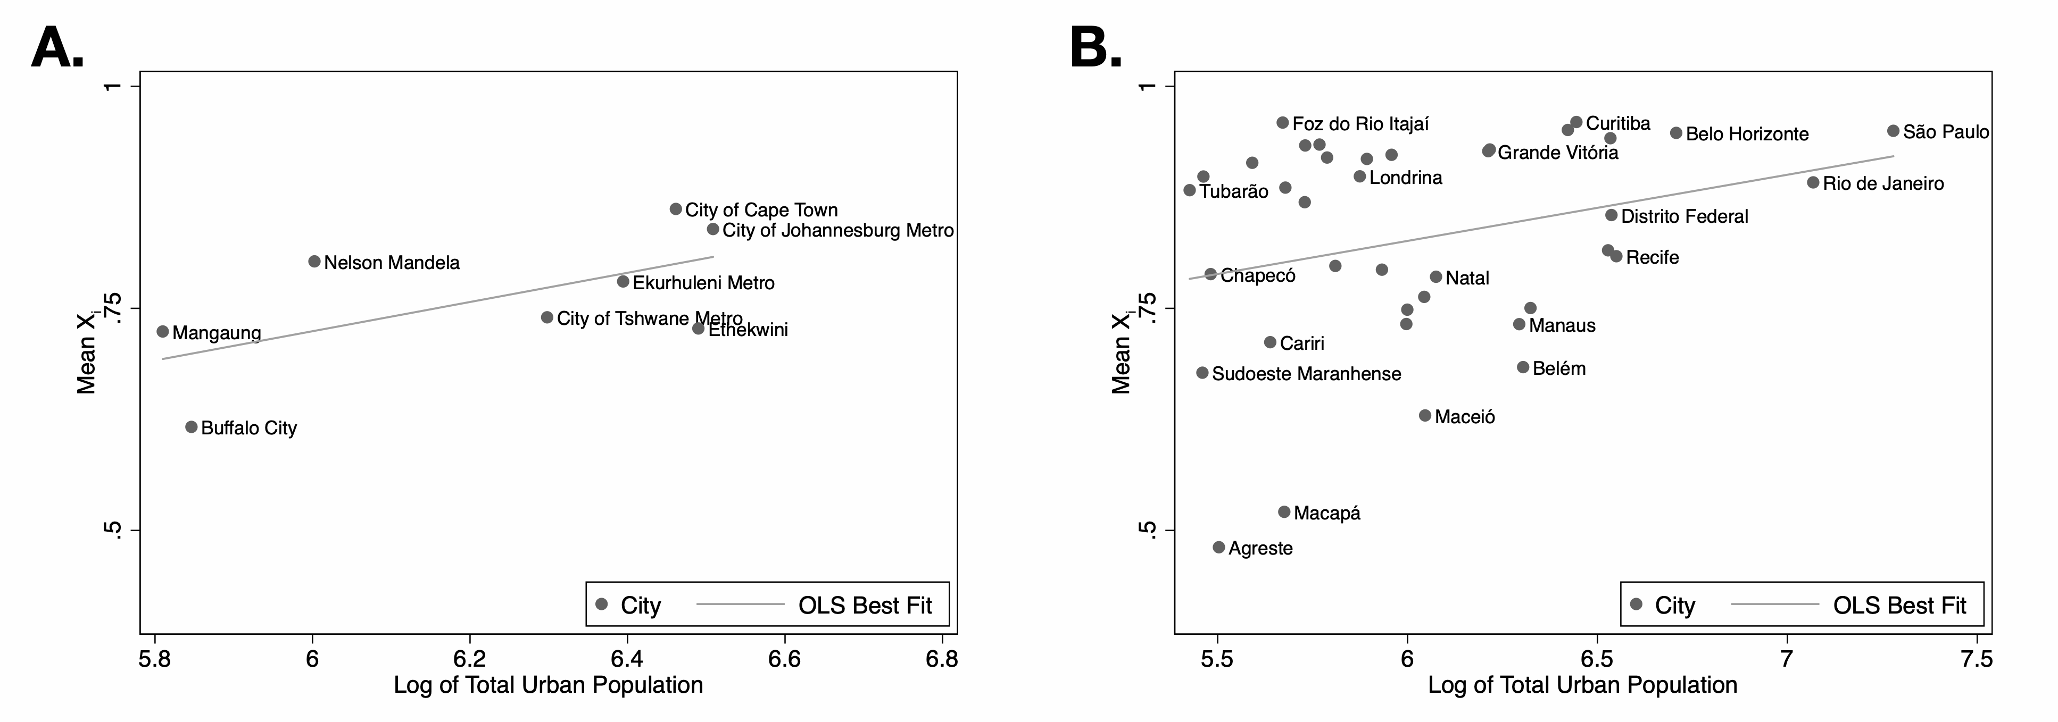
City size effect
Notes:
here we show the mean X for urban areas of different sizes in Brazil and South Africa. In general, we find that the level of service access increases with city size a trend that is especially clear in South Africa. This relative advantage of cities in terms of access to services and thus, at least some of the dimensions of sustainable development, is consistent with urban agglomeration effects and points to a range of reasons why urbanization rates continue to grow in developing cities beyond strictly economic motifs. living in larger cities means that, on average, citizens obtain greater access to measures of sustainable development sooner. However, these averages hide large heterogeneities in access, an issue to which we now turn.

Slide 15
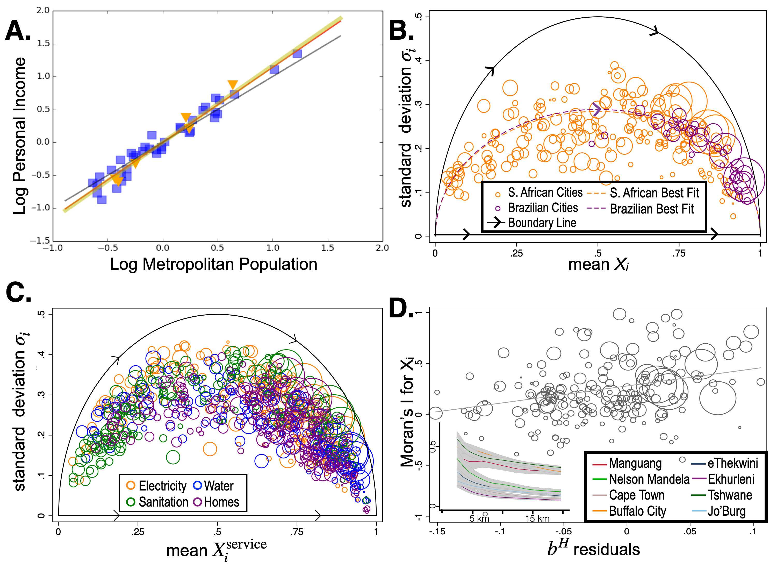
Inequality vs development
Superlinear scaling
Inequality vs development
Neighborhood polarization vs inequality (1km scale)

Slide 16
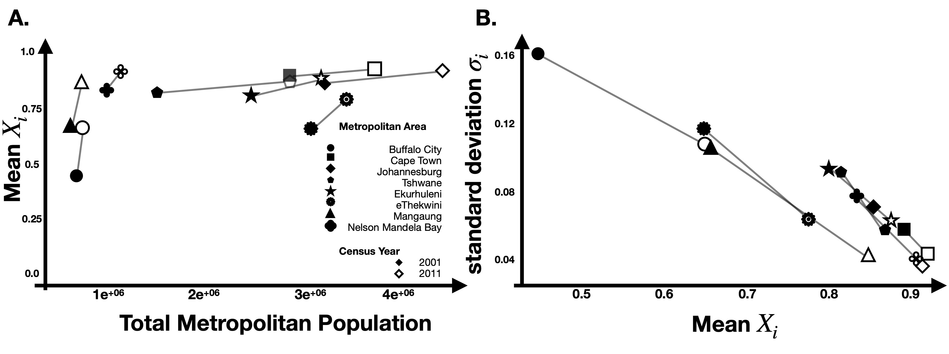
Development and reduction of inequality
More people gain services down the urban hierarchy over time
Figures by Mollie Gaines (ORNL SULI student)
Innovations typically travel down the urban hierarchy from larger to smaller cities

